Slide 1
Cloud Security
Presented By:
Student Name:A.Nishanth
College Name:The Kavery Engineering College
Department:B.E-Computer Science and Engineering

Slide 2
INTRODUCTION
Cloud security refers to the set of policies, technologies, controls, and procedures implemented to protect data, applications, and infrastructure hosted in cloud environments. With the widespread adoption of cloud computing, organizations are increasingly relying on cloud services to store, process, and manage their data. However, this shift also introduces new security challenges and considerations due to the shared responsibility model inherent in most cloud deployments.

Slide 3
OUT LINES
Problem Statement (Should not include solution)
Proposed System/Solution
System Development Approach (Technology Used)
Algorithm & Deployment
Result (Output Image)
Conclusion
Future Scope
References

Slide 4
PROBLEM STATEMENT
The problem statement for cloud security revolves around the challenges organizations face in adequately protecting their data, applications, and infrastructure in cloud environments. Despite the numerous benefits of cloud computing, such as scalability, flexibility, and cost-effectiveness, several security concerns persist:
Data Breaches: The risk of unauthorized access to sensitive data stored in the cloud is a significant concern. Data breaches can occur due to misconfigurations, insider threats, or sophisticated cyberattacks targeting cloud environments

Slide 5
PROPOSED SYSTEM & SOLUTION
Proposing a system and solutions for cloud security involves implementing a comprehensive set of measures to mitigate risks and protect assets in cloud environments. Here are some key components and strategies for enhancing cloud security:
Encryption: Implementing encryption for data both in transit and at rest helps safeguard sensitive information from unauthorized access. Use strong encryption algorithms and key management practices to ensure the confidentiality and integrity of data stored in the cloud.
Identity and Access Management (IAM): Strengthen IAM practices by enforcing least privilege principles, implementing multi-factor authentication (MFA), and regularly reviewing and revoking access permissions. Utilize centralized IAM solutions to manage user identities and access controls across cloud services.
Network Security: Deploy network security controls such as firewalls, intrusion detection and prevention systems (IDS/IPS), and virtual private networks (VPNs) to protect cloud environments from external threats. Implement network segmentation to isolate critical workloads and limit the impact of security incidents.

Slide 6
Continuous Monitoring and Threat Detection: Implement robust monitoring and logging mechanisms to track user activities, detect suspicious behavior, and identify potential security incidents in real-time. Utilize security information and event management (SIEM) systems, intrusion detection systems (IDS), and anomaly detection techniques to enhance threat detection capabilities.
Data Loss Prevention (DLP): Deploy DLP solutions to prevent the unauthorized disclosure or leakage of sensitive data in the cloud. Implement data classification policies, encryption controls, and data loss prevention rules to monitor and protect data across cloud services.
Incident Response Planning: Develop and document an incident response plan outlining procedures for detecting, assessing, and responding to security incidents in the cloud. Conduct regular tabletop exercises and simulations to test the effectiveness of the incident response plan and ensure readiness to handle security incidents effectively.

Slide 7
System Development Approach
Developing a cloud security system involves a systematic approach that encompasses planning, implementation, testing, and ongoing refinement. Here's a structured development approach for building a robust cloud security system:
Define Security Requirements: Start by clearly defining the security requirements for your cloud environment based on the organization's needs, regulatory obligations, and risk tolerance. Identify the types of data and applications that will be hosted in the cloud, as well as the security controls and measures necessary to protect them.
Risk Assessment and Threat Modeling: Conduct a comprehensive risk assessment and threat modeling exercise to identify potential security threats and vulnerabilities specific to your cloud environment. Evaluate the likelihood and potential impact of these threats on business operations and prioritize security measures accordingly.
Select Cloud Security Solutions: Choose the appropriate security solutions and tools based on your security requirements and risk assessment findings. This may include selecting cloud-native security services provided by the cloud service provider (CSP), as well as third-party security products and solutions tailored to address specific security challenges.

Slide 8
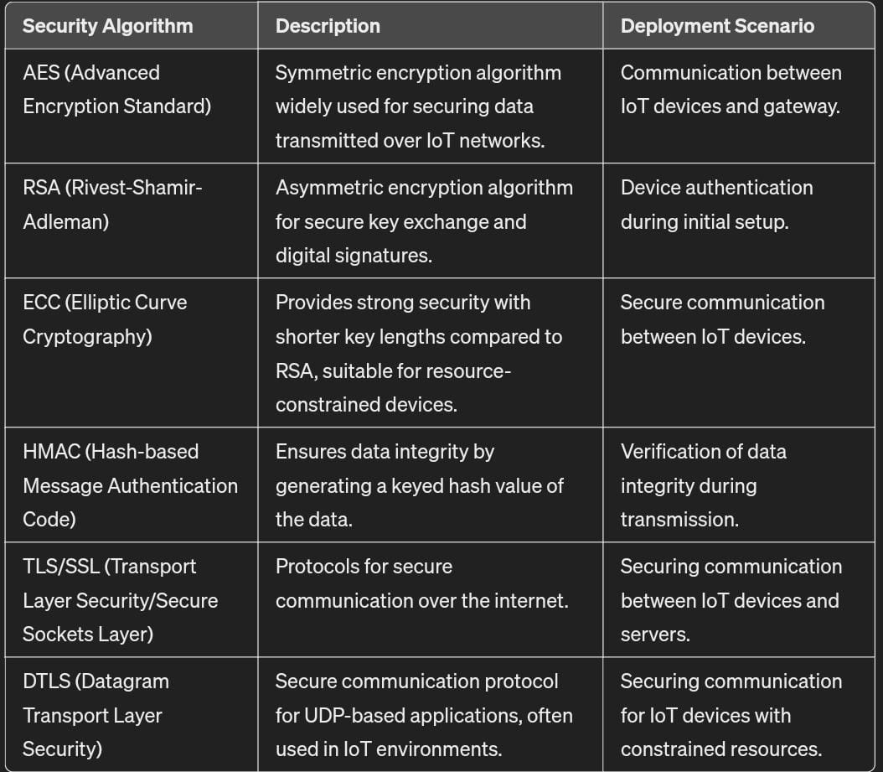
Algorithm & Deployment

Slide 9
import hashlib
from cryptography.fernet import Fernet
# Function to encrypt data using Fernet symmetric encryption
def encrypt_data(data, key):
cipher_suite = Fernet(key)
encrypted_data = cipher_suite.encrypt(data.encode())
return encrypted_data
# Function to decrypt data using Fernet symmetric encryption
def decrypt_data(encrypted_data, key):
cipher_suite = Fernet(key)
decrypted_data = cipher_suite.decrypt(encrypted_data).decode()
return decrypted_data
# Function to generate a SHA-256 hash of a password
def generate_hash(password):
hashed_password = hashlib.sha256(password.encode()).hexdigest()
return hashed_password
# Example usage of encryption and decryption functions
def main():
# Generate a symmetric encryption key
key = Fernet.generate_key()
# Encrypt sensitive data
sensitive_data = "This is confidential information."
encrypted_data = encrypt_data(sensitive_data, key)
print("Encrypted Data:", encrypted_data)
# Decrypt encrypted data
decrypted_data = decrypt_data(encrypted_data, key)

Slide 10
print("Decrypted Data:", decrypted_data)
# Generate a hash of a password
password = "P@ssw0rd"
hashed_password = generate_hash(password)
print("Hashed Password:", hashed_password)
if _name_ == "_main_":
main()

Slide 11
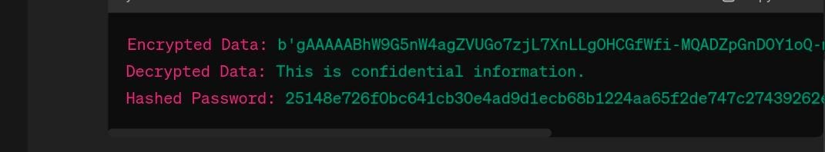
RESULT(OUTPUT)

Slide 12
CONCLUSION
In conclusion, cloud security is a critical aspect of modern IT infrastructure, essential for protecting data, applications, and infrastructure hosted in cloud environments. As organizations increasingly rely on cloud computing to store, process, and manage their data, it becomes imperative to implement robust security measures to mitigate risks and ensure the confidentiality, integrity, and availability of cloud resources

Slide 13
FUTURE SCOPE
Homomorphic encrypt
Artificial intelligent and machine learning
Container Security
Security as a service
Zero trust architecture
DevSecOps integration
Cloud-Native security

Slide 14
REFERENCE
Center for Internet Security (CIS) - Cloud Security": CIS provides benchmarks, best practices, and resources to help organizations secure their cloud environments effectively. Their CIS Controls and CIS Benchmarks offer practical guidance for implementing security controls and configurations in cloud environments.
Website: https://www.cisecurity.org/cis-benchmarks/
"Microsoft Azure Security Documentation": Microsoft Azure offers comprehensive documentation on security best practices, compliance, and governance for organizations leveraging the Azure cloud platform. Their documentation covers a wide range of topics, including identity and access management, data protection, and network security.
Website: https://docs.microsoft.com/en-us/azure/security/
"Amazon Web Services (AWS) Security Documentation": AWS provides extensive documentation on security features, services, and best practices for securing workloads and data in the AWS cloud. Their documentation includes whitepapers, guides, and tutorials covering various aspects of AWS security.
Website: https://aws.amazon.com/security/

Slide 15
THANK YOU...

